Slide 1
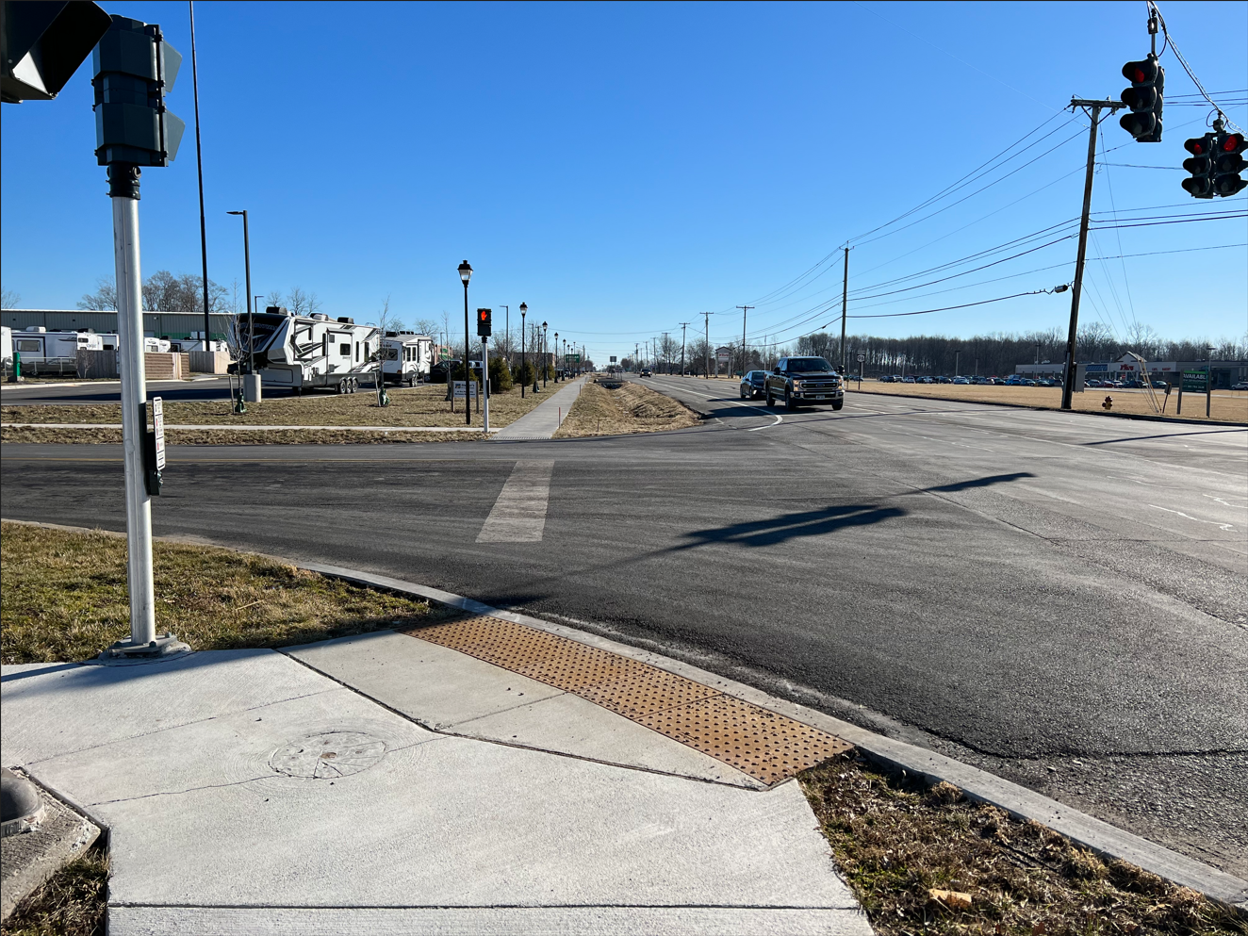
Farmington Sidewalk/Trail Connection Project
Public Information Meeting
May 4, 2023| 6:30 – 8:30 p.m.
Farmington Town Hall & Zoom
Sponsored by:
Town of Farmington, Federal Highway Administration & NYSDOT

Slide 2

Meeting Agenda
Introductions
  Town of Farmington: Ron Brand
  NYSDOT LDSA Program Liaison: Jon Harman
  Consultant: Fisher Associates
    Emily Smith, P.E.
    Pete Wlodarczyk, P.E.
Sign In
Project History/Detailed Description
Questions/Comments/Feedback

Slide 3
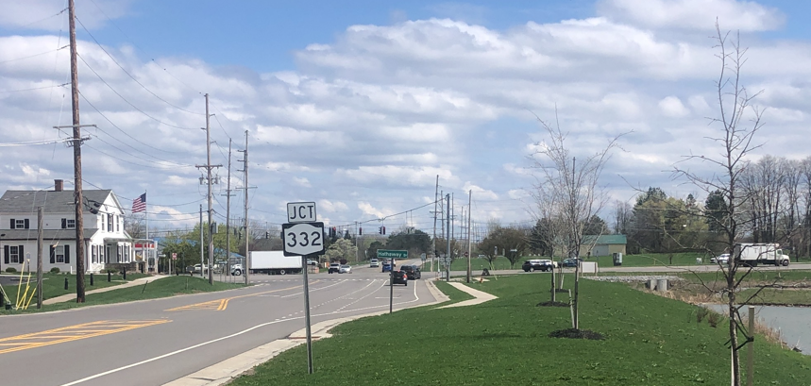
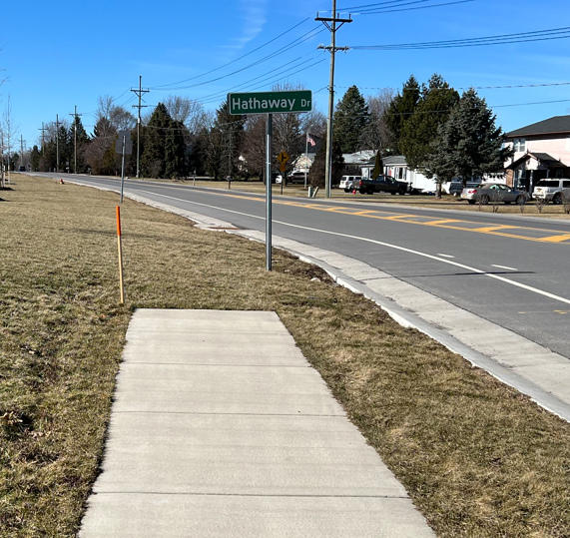
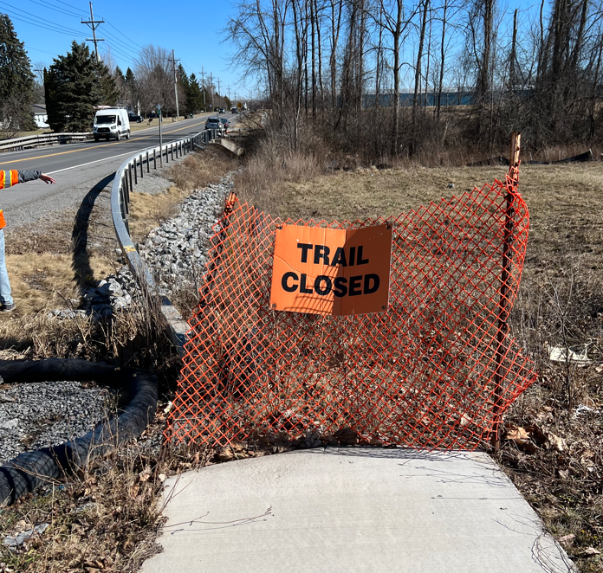
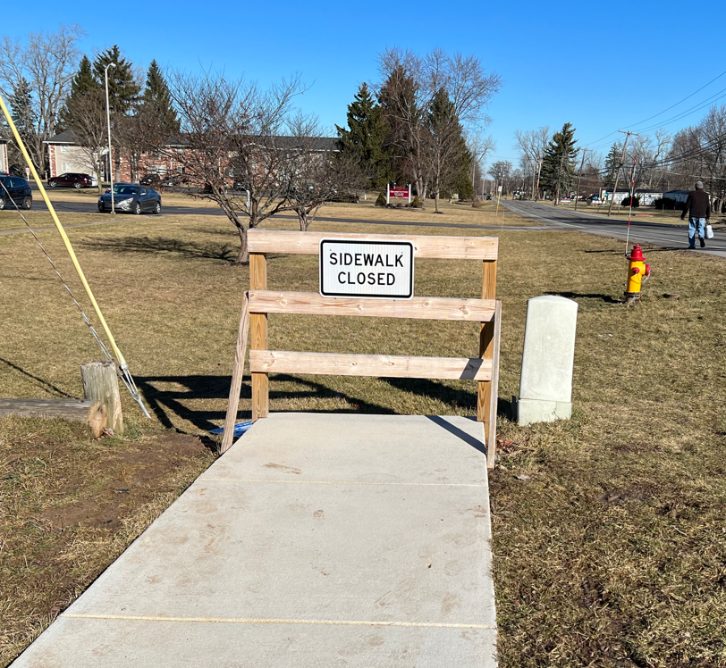
Project Description
The project will connect sidewalks and trail connections to fill the gaps in the existing pedestrian sidewalk and trail network.

Slide 4

Project Alternatives
  Null Alternative
  Maintenance only
  Maintains the existing sidewalk network with no improvements
  Alternative 1
  Increases safety for pedestrians by providing sidewalks/trail paths that connect to existing facilities
  Proposed pedestrian bridge provides safe crossing over Beaver creek

Slide 5
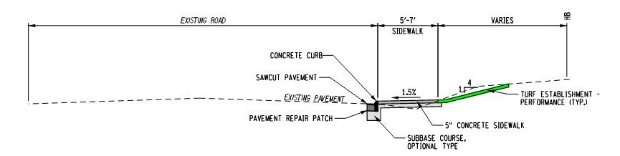
Typical Sections
Concrete Sidewalk with Curb
  Match adjacent sidewalk section
  Areas to minimize grading
  Tight ROW or other existing features
Notes:
Please add some bullets as to why we would choose this section

Slide 6
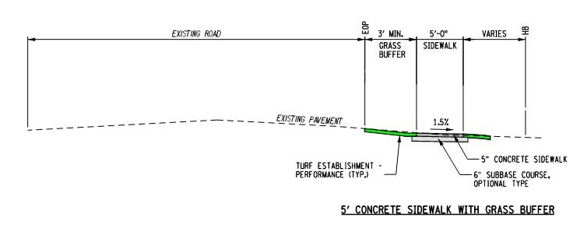
Typical SEctions
Concrete Sidewalk with Buffer
  Match adjacent sidewalk section
  Maintain existing drainage swales
  More available space
  More aesthetic/snow storage
Notes:
Please add some bullets as to why we would choose this section

Slide 7
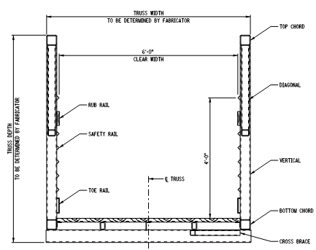
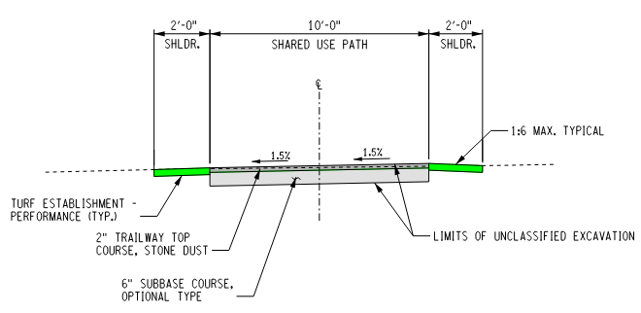
Typical Sections
Trail and Bridge

Slide 8
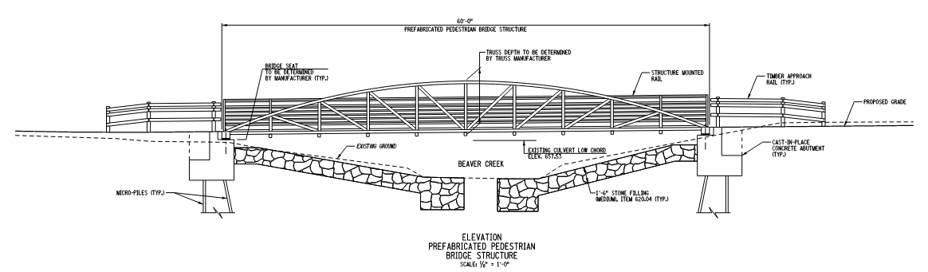
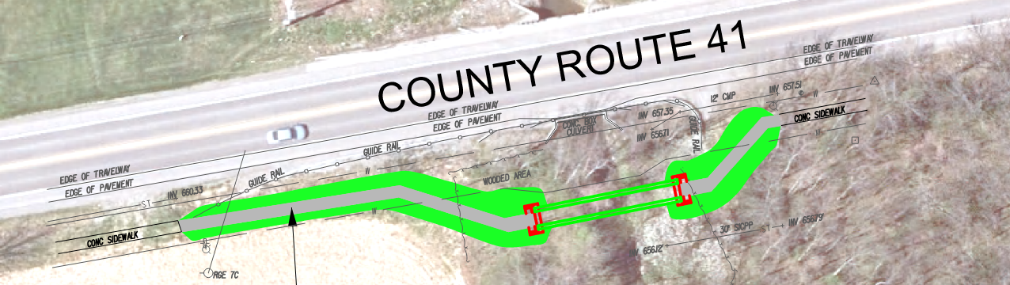
Project Approach
Pedestrian Bridge

Slide 9
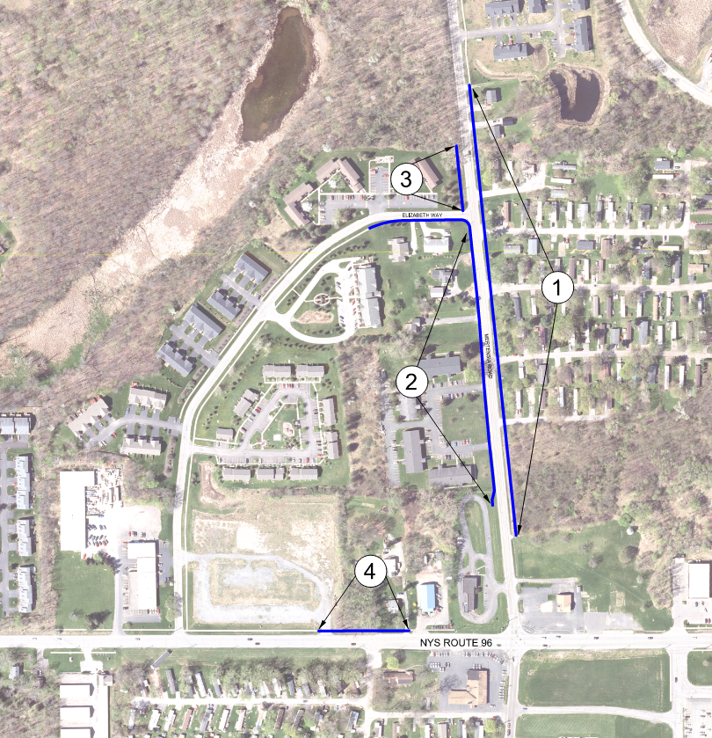
Project Approach
Proposed Work – Priority Areas
Area 1: East Side of Mertensia Road
From Collett Woods Townhouse Project to Meyer’s RV site
Typical section – Sidewalk with Buffer
Area 2: West Side of Mertensia Road
From Auto Wash site to intersection of Elizabeth Way
Typical section – Sidewalk with Buffer
Area 3: West Side of Mertensia Road
North of intersection of Elizabeth Way
Typical section – Sidewalk with Buffer
Area 4: North Side of State Route 96
From Difelice’s vacant parcel to Matties Power Sports
Typical section – Sidewalk with Buffer
Notes:
The areas should also indicate which typical section applies there

Slide 10
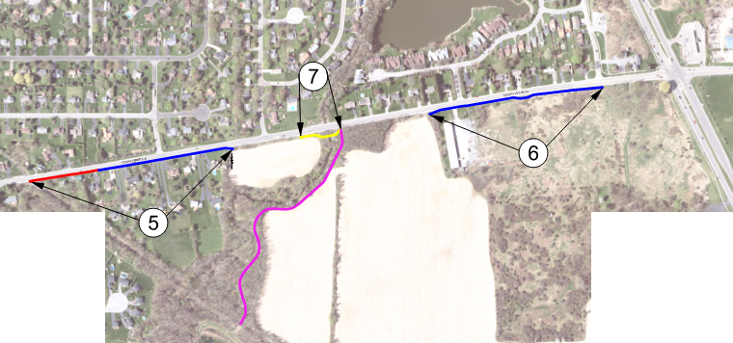
Project Approach
Proposed Work – Priority Areas
Area 5: South Side of County Route 41
From Auburn trail crossing to existing sidewalk at west end of Hathaway’s Corners Incentive Zoning Site
Typical sections – Sidewalk with Buffer and Curb
Area 6: South Side of County Route 41
From intersection with Savalla Blvd. to the existing sidewalk at the intersection of State Route 322
Typical section – Sidewalk with Buffer
Area 7: Pedestrian Bridge Crossing Beaver Creek
South side of County Route 41
Typical section – Sidewalk with Buffer
Notes:
The areas should also indicate which typical section applies there

Slide 11
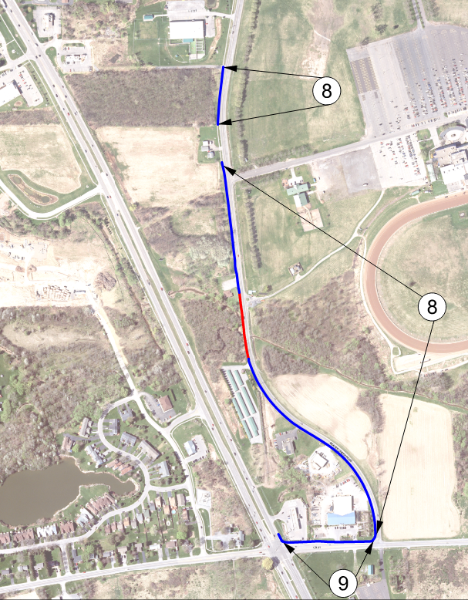
Project Approach
Proposed Work – Priority Areas
Area 8: West Side of Beaver Creek Road and North or Beaver Creek crossing
Between State Route 96 on the north and County Route 41 on the south
Typical section – Sidewalk with Buffer
Area 9: North Side of County Road 41
From intersection with State Route 332 to Beaver Creek Road
Typical section – Sidewalk with Buffer
Notes:
The areas should also indicate which typical section applies there

Slide 12
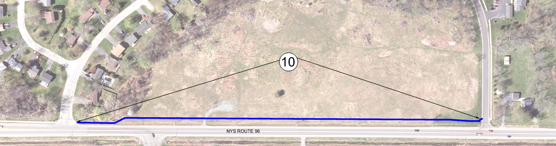
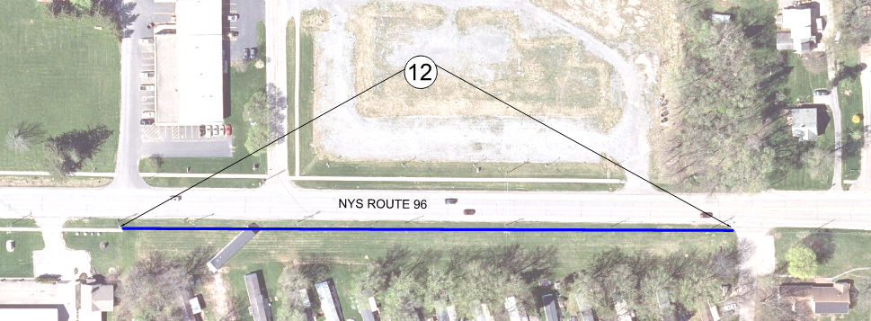
Project Approach
Proposed Work – Priority Areas
Area 10: North Side of State Route 96
From Glen Carlin Drive to Fairdale Glen
Typical section – Sidewalk with Buffer and Curb
Area 12: South Side of State Route 96
From Riedman Office to Byrne Dairy
Typical section – Sidewalk with Buffer
Notes:
The areas should also indicate which typical section applies there

Slide 13
Work to Date
Design Survey
Preliminary Design and Cost Estimates
Environmental Screenings, Preliminary Investigations

Slide 14

Next Steps
Finalize design concepts based on public input
Town and NYSDOT to grant Design Approval
Develop detailed design documents
Obtain permits
Advertise for bids
Construct the sidewalk/trail
connections and pedestrian
bridge

Slide 15

Project Schedule
The following are considered key project dates:
Design Approval May/June 2023
Final Plans, Specifications & Estimate November 2023
Project Advertisement December 2023
Bid Opening January 2024
Contract Award February 2024
Construction Completion October 2024

Slide 16
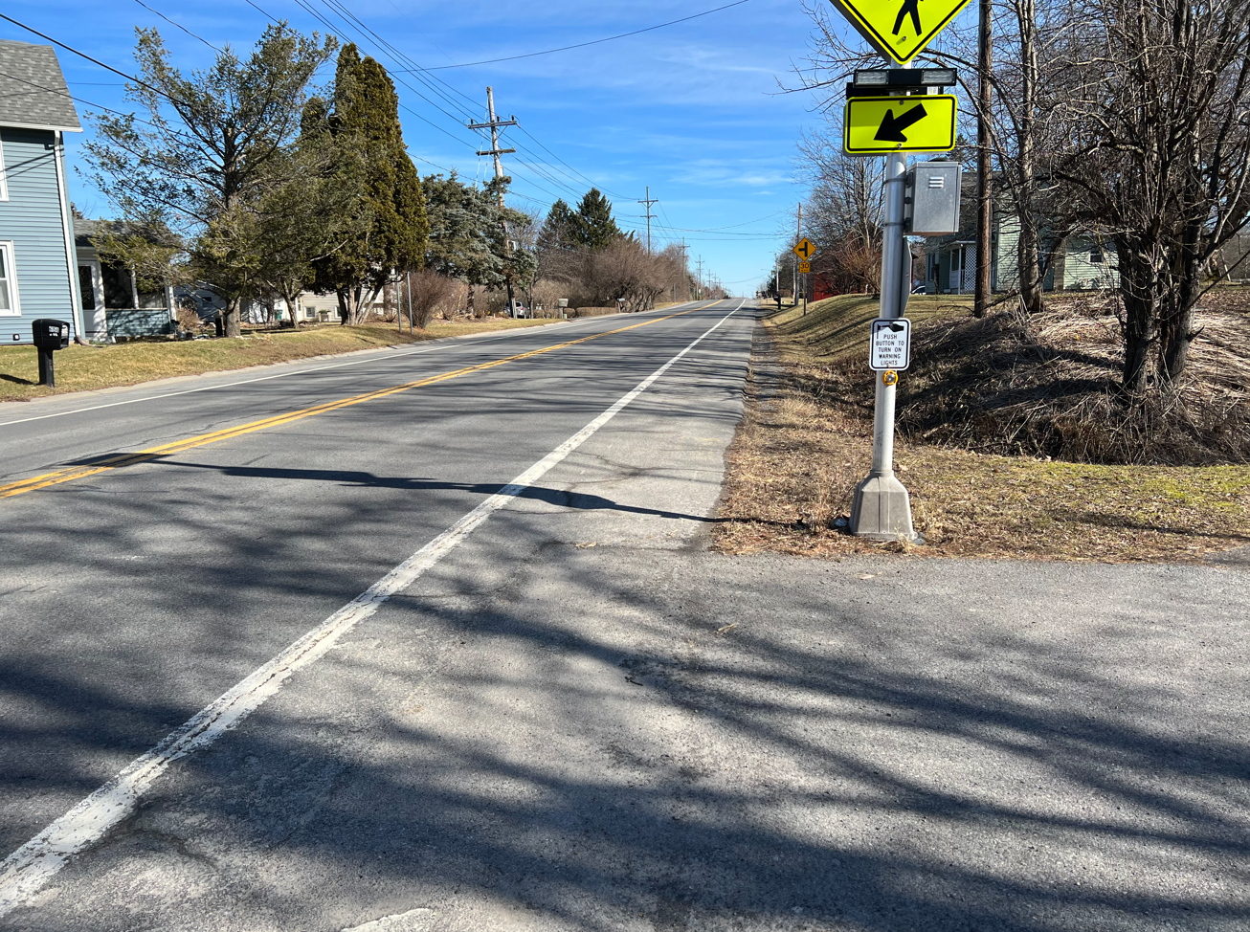

Questions+Answers

